Slide 1
Debugging a Microcontroller Program: Part 1
Embedded Software Essentials
C2 M3 V7

Slide 2
Testing Software [S1a]
Debugger: Software application that connects to embedded system’s target application
Host PC
Debugger Hardware
Debug SW
Microcontroller
DAP
CPU
Registers
Flash
SRAM
Peripherals
GPIO
Registers
Registers

Slide 3
Testing Software [S1b]
Debugger: Software application that connects to embedded system’s target application
Debuggers allow users to
Observe Behavior
Control Behavior
Host PC
Debugger Hardware
Debug SW
Debug Access Port (DAP)
Microcontroller
DAP
CPU
Registers
Flash
SRAM
Peripherals
GPIO
Registers
Registers

Slide 4
Testing Software [S1c]
*Not always required
Debugger: Software application that connects to embedded system’s target application
E,g: GNU Debugger (gdb)
Debuggers allow users to
Observe Behavior
Control Behavior
Host PC
Debugger Hardware
Debug SW
gdb
Debug Access Port (DAP)
Microcontroller
DAP
CPU
Registers
Flash
SRAM
Peripherals
GPIO
Registers
Registers

Slide 5
Debuggers [S2a]
Main Tasks:
Connect to development board
Program an application
Debug an application
Host PC
Debugger Hardware
Debug SW
gdb
Microcontroller
DAP
CPU
Registers
Flash
SRAM
Peripherals
GPIO
Registers
Registers
Notes:
Addison, C. (2015, December 11). Code Composer Studio v6 [Digital image]. Retrieved November 08, 2016, from https://e2e.ti.com/blogs_/b/toolsinsider/archive/2015/12/11/helpful-tips-executing-code-from-ram

Slide 6
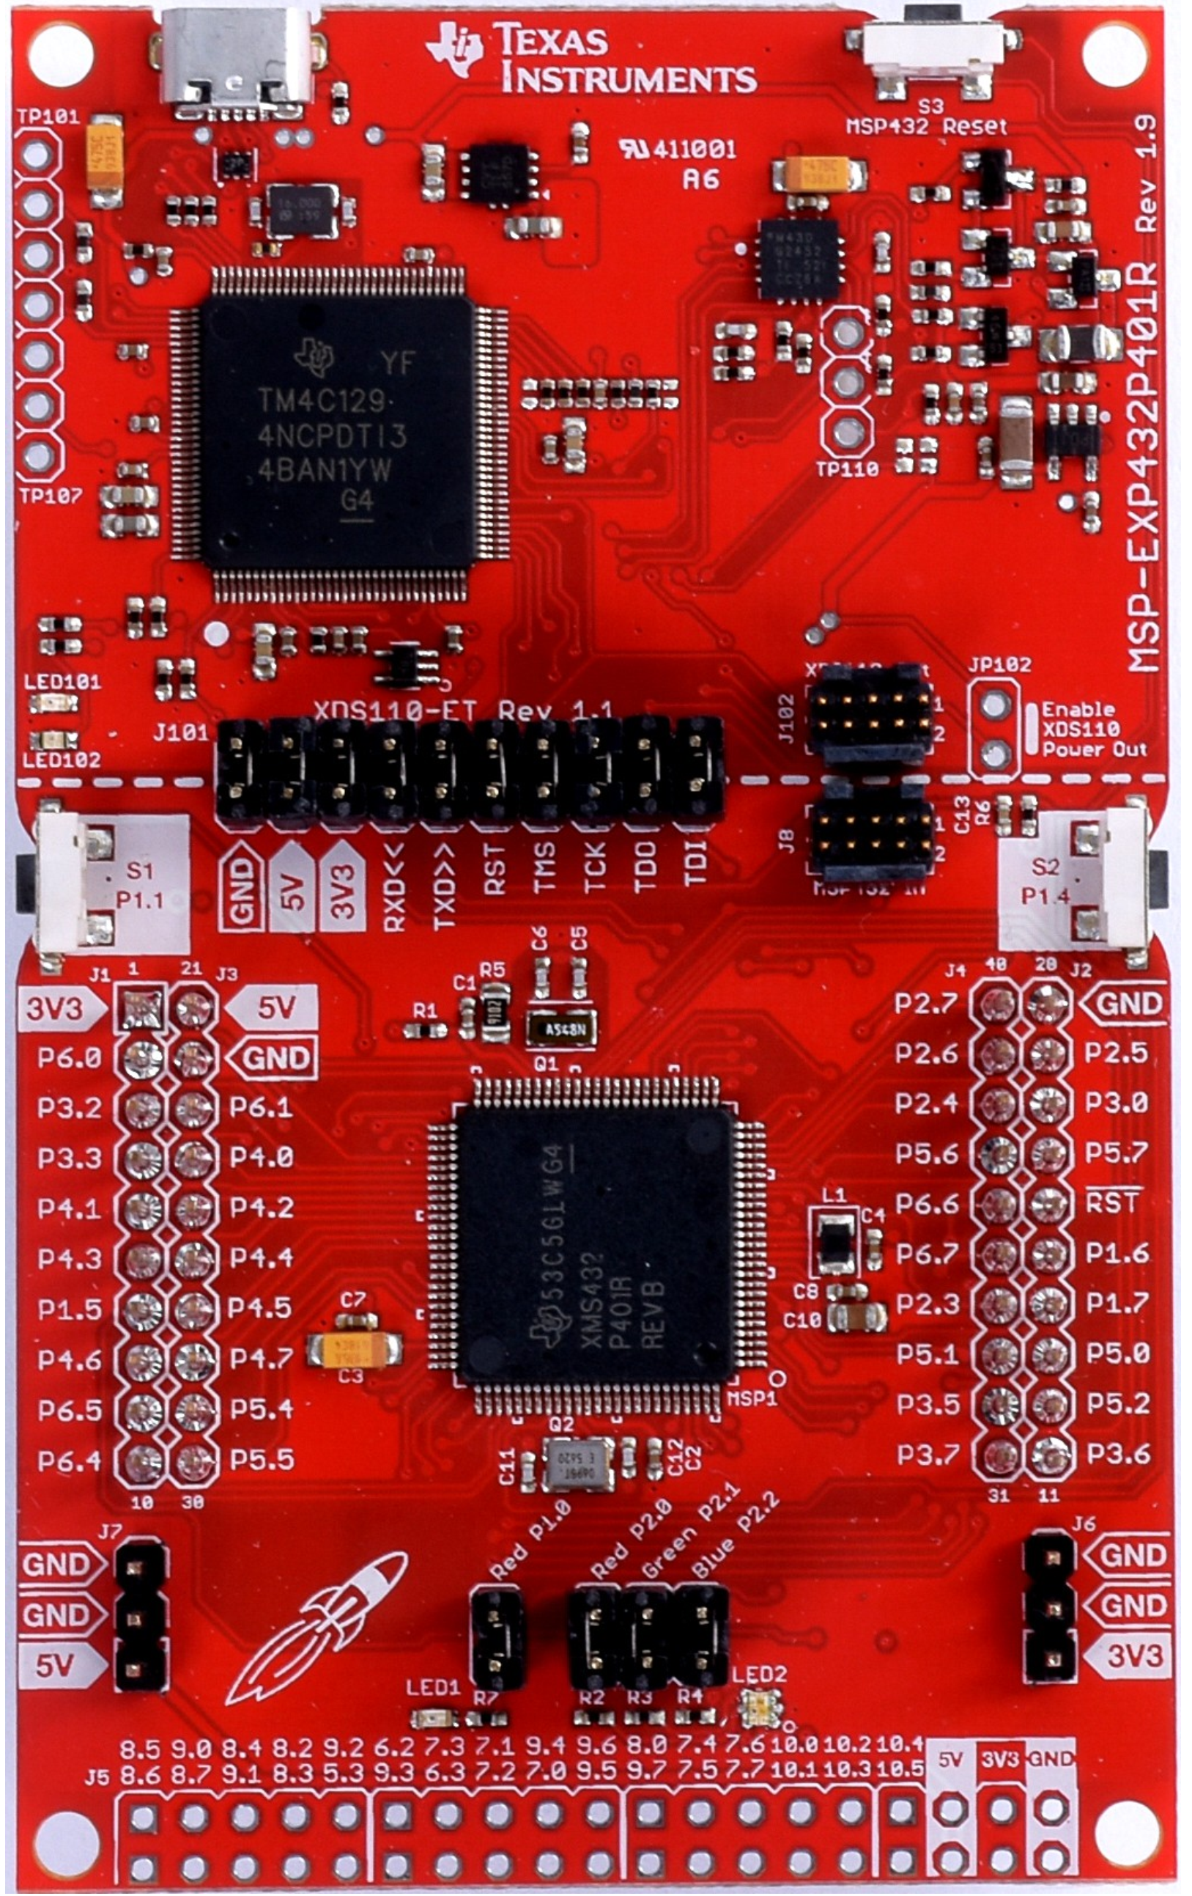
Debuggers [S2a]
Host PC
Main Tasks:
Connect to development board
Program an application
Debug an application
Requires software application running on a host machine
Debug SW
XDS-110ET
On Board Programmer / Debugger
DAP is internal to target Microcontroller
Notes:
http://www.ti.com/lit/ug/slau597c/slau597c.pdf

Slide 7
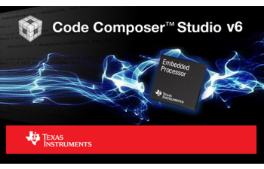
Debuggers [S2c]
Main Tasks:
Connect to development board
Program an application
Debug an application
Requires software application running on a host machine
Code Composer Studio (CCS)
Texas Instruments IDE with Debugger
XDS-110ET
On Board Programmer / Debugger
DAP is internal to target Microcontroller
Notes:
Addison, C. (2015, December 11). Code Composer Studio v6 [Digital image]. Retrieved November 08, 2016, from https://e2e.ti.com/blogs_/b/toolsinsider/archive/2015/12/11/helpful-tips-executing-code-from-ram
http://www.ti.com/lit/ug/slau597c/slau597c.pdf

Slide 8
Debug Symbols [S3]
Must enable debug symbols at compilation
-g flag
Provides mechanism for debugger to interpret executing code and map to original source code
$ arm-none-eabi-gcc –g main.c –o main.o
Microcontroller
Source Code
Debug Application
DAP
Executing Application
(Machine Code)
Commands and Data Sent between application and Microcontroller)
Symbol Table
Memory (SRAM/Flash)

Slide 9
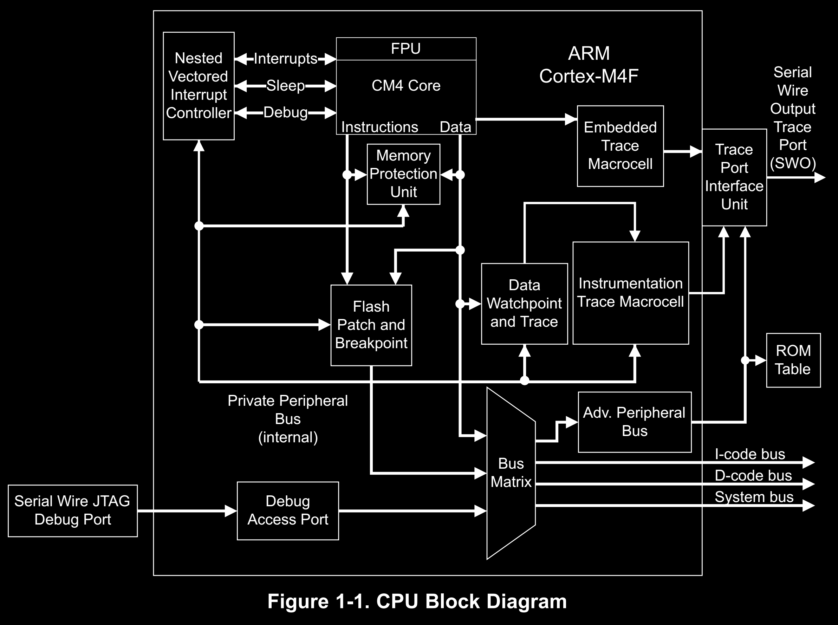
Debug Access Port [S4a]
Built in debug port called Debug Access Port (DAP)
Supports multiple debugging interfaces
Joint Test Action Group (JTAG)
Serial Wire Debug (SWD)
Notes:
http://www.ti.com/lit/ug/slau356f/slau356f.pdf

Slide 10
Debug Access Port [S4a]
Built in debug port called Debug Access Port (DAP)
Supports multiple debugging interfaces
Joint Test Action Group (JTAG)
Serial Wire Debug (SWD)
Notes:
http://www.ti.com/lit/ug/slau356f/slau356f.pdf

Slide 11
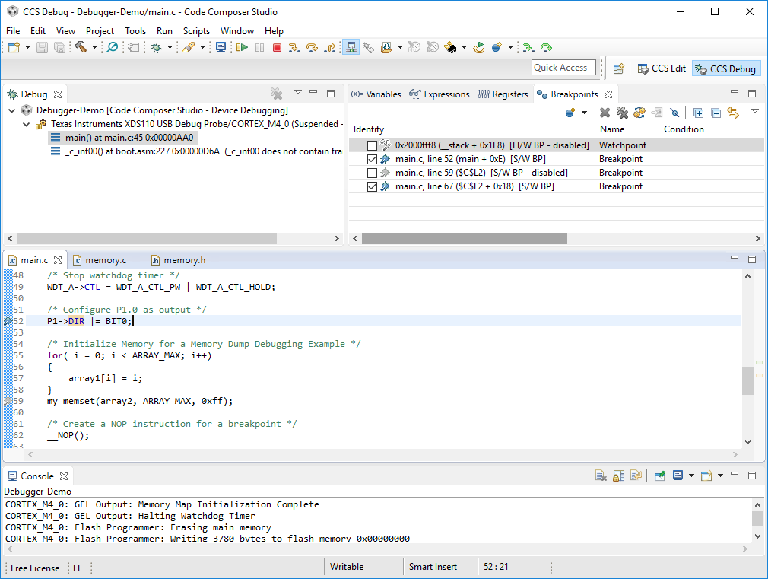
Breakpoints [S5a]
blink.c
Mechanism to stop or pause the current execution of a program
Program must be un-paused or restarted a breakpoint occurs
Limited number of breakpoints allowed

Slide 12
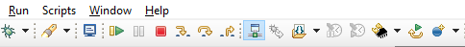
Breakpoints [S5b]
Breakpoint Indicator
blink.c
Mechanism to stop or pause the current execution of a program
Program must be un-paused or restarted a breakpoint occurs
Limited number of breakpoints allowed
Play
Step Out
Pause
Step Over
Step Into

Slide 13
Watch Points [S6a]
Mechanism to stop or pause the current execution of a program when a variable or expression changes
Can happen at any point in the program
Example:
Set watch point on variable i. Anytime i changes, break. This should occur 16 times in this code excerpt
uint32_t i = 0;
for (i = 0; i < 16; i++)
{
/* Other Code Here*/
}

Slide 14
Breakpoints & Watchpoints [S7a]
Microcontroller can miss data or external events if processor is paused
Host PC
Debugger Hardware
Debug SW
Microcontroller
DAP
Serial device is transmitting sequence of packets
CPU
Registers
Flash
RX
Serial device
(UART)
SRAM
UART
Registers
TX
Peripherals
GPIO
Registers
Registers

Slide 15
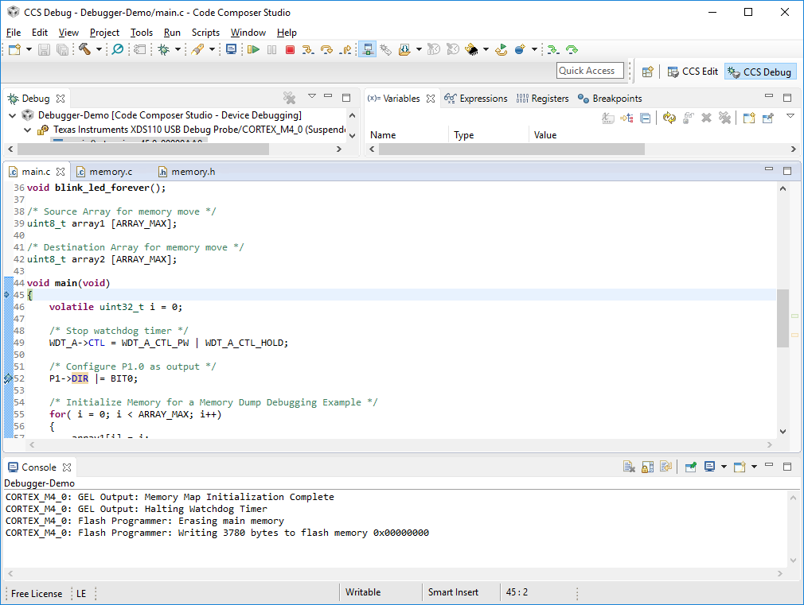
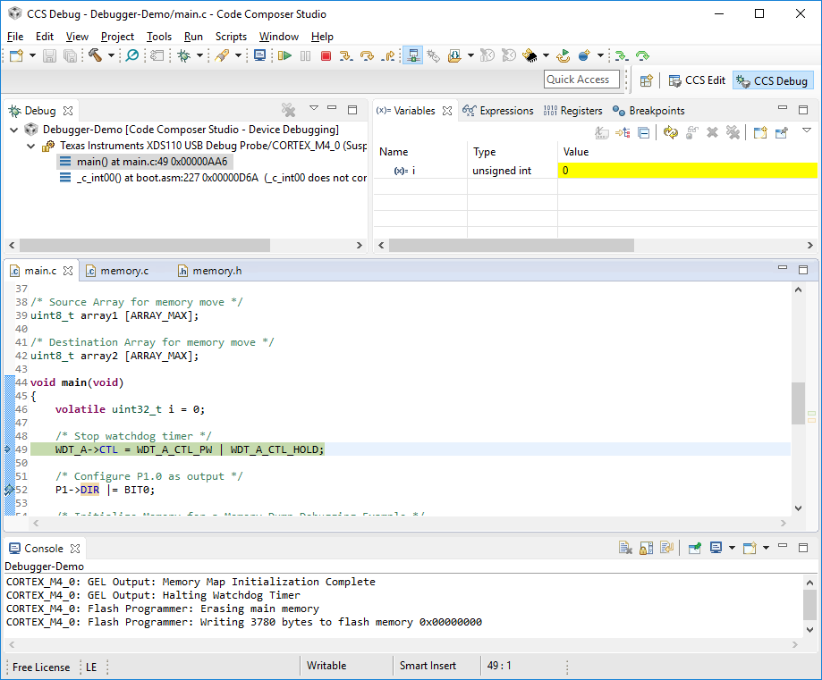
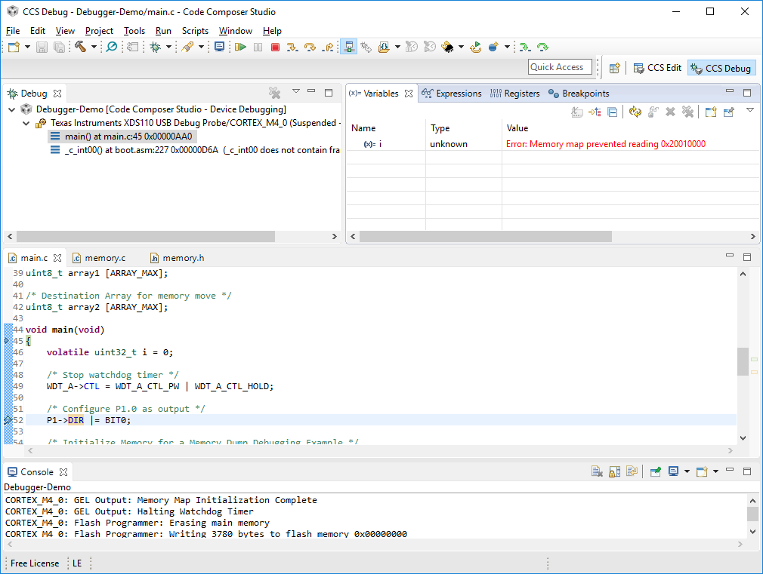
Variable Scope [S8a]
Before Entry to Main
Variables view allows you to see value while in current scope
Must be paused to read value
Can inject any value during a pause for testing
Before Initialization
After Initialization

Slide 16
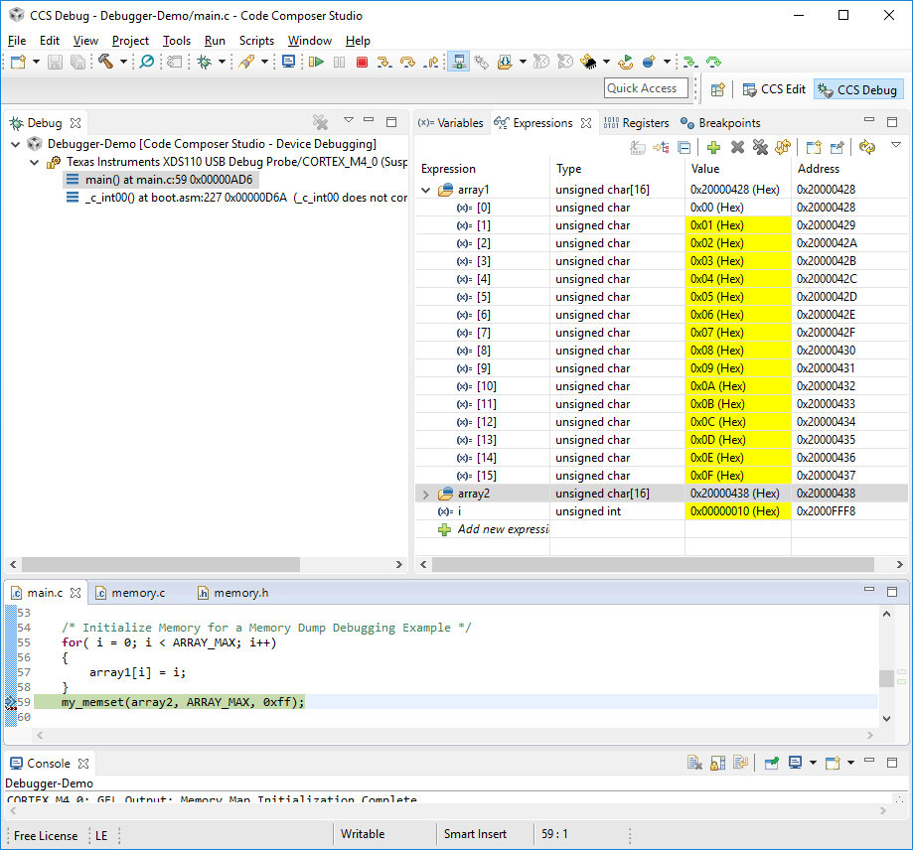
Expressions [S9a]
Expressions view allows you to see any global variable, register or general expression
Can write c-expressions in here and they are evaluated at runtime
Must be paused to read values
Breakpoint after array1 initialized

Slide 17
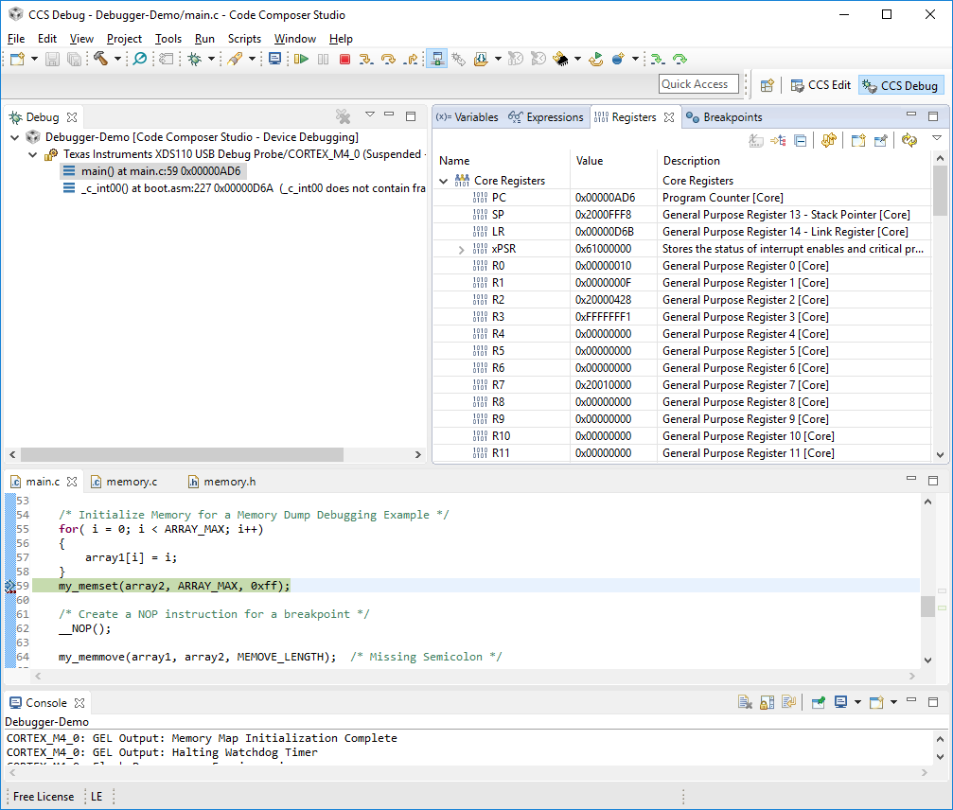
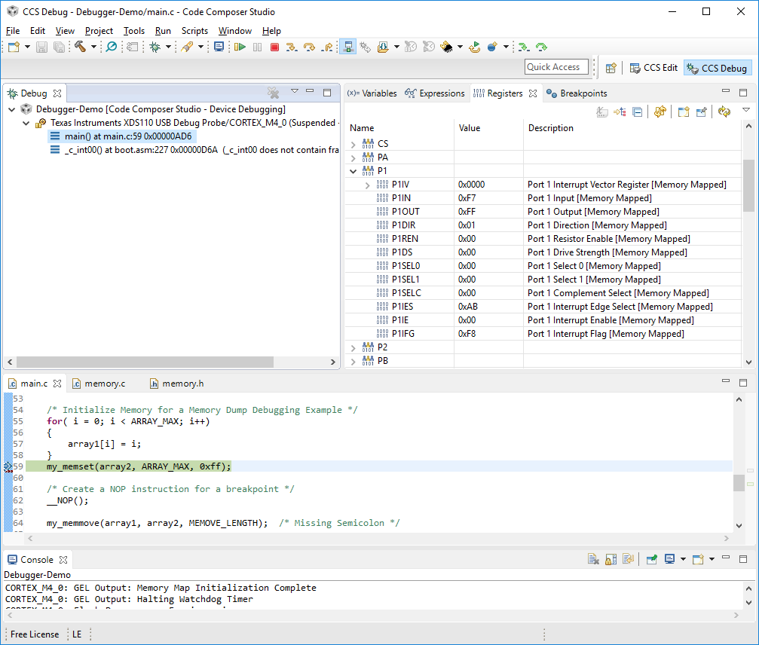
Registers [S10a]
Register view allows you to view
Core CPU Registers
General Purpose
Special Purpose
Peripheral Registers
Must be paused to read values
Can inject any value into register bit fields during a pause for testing

Slide 18
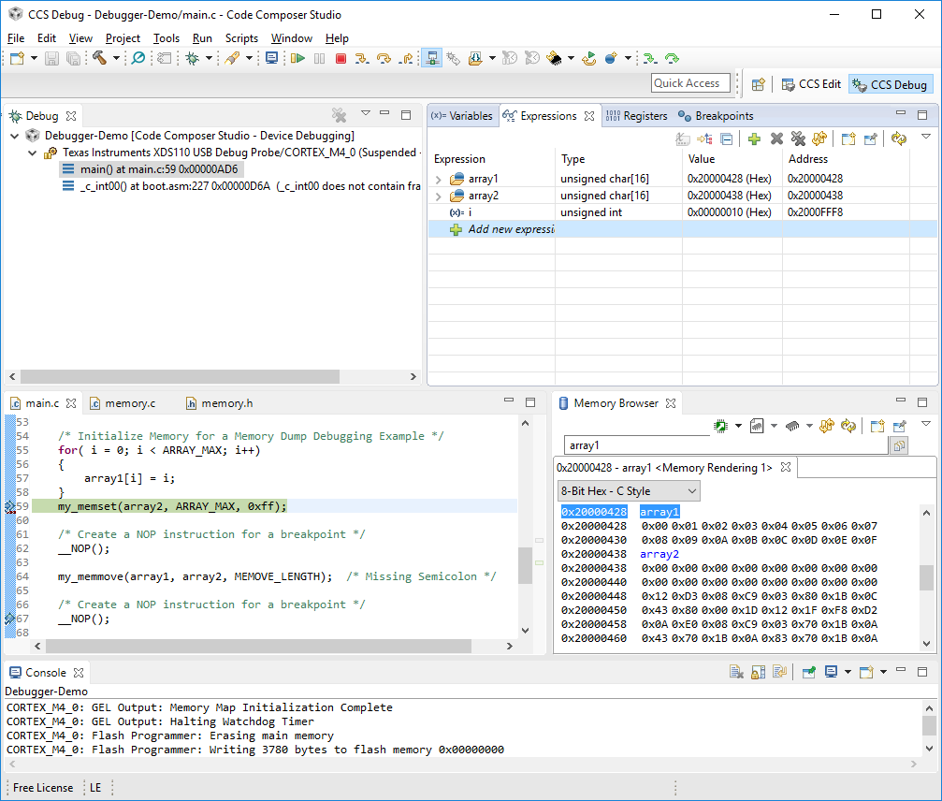
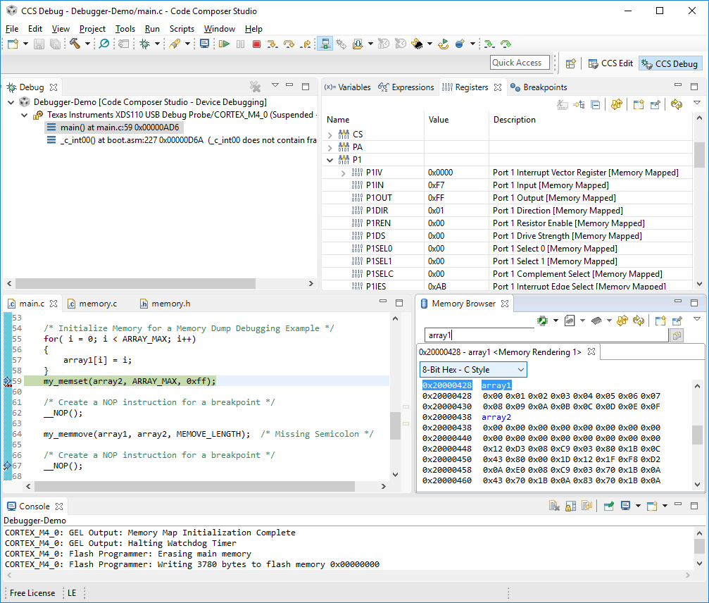
Memory Browser [S11a]
Memory Browser allows you to view and alter memory directly at different accessible addresses
Can format memory view many ways
Must be paused to read values
array1 & array2 addresses

Slide 19
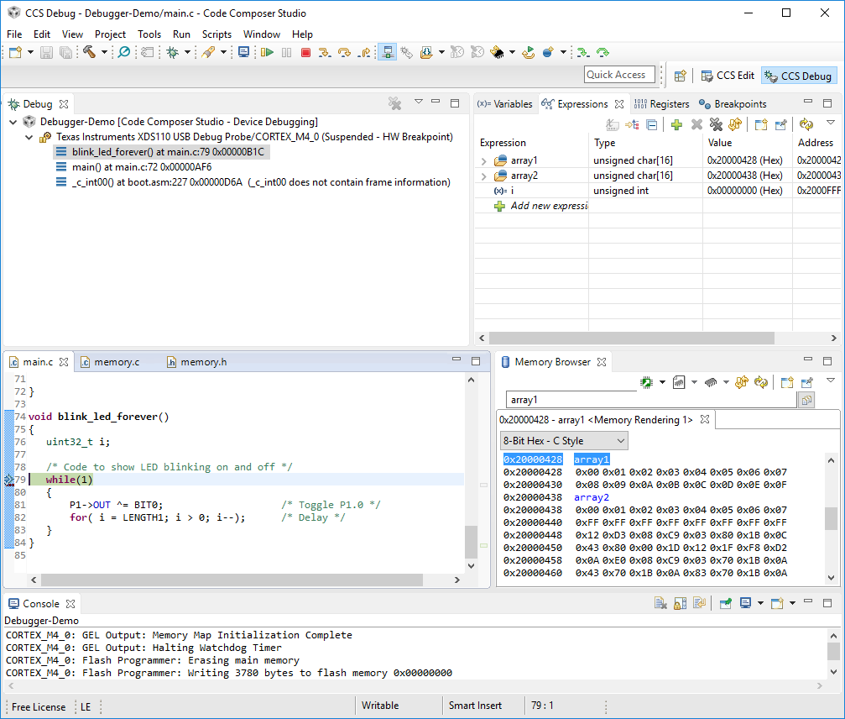
Stack Trace [S12a]
Allows you to determine the function call hierarchy by looking at the stack
Stack provides history of call frames
Must be paused to read current call stack
Very helpful for multi-threaded programs
Main calls blink_led_forever()
Main is called by _c_int00()

